Slide 1
UKI NETS 21st National Conference
Monday 2nd December 2024
Mercure Holland House Hotel, Cardiff.
“Clinical Trials Overview”
Dr Alan Anthoney
(St James University Hospital, Leeds)

Slide 2
UKI NETS 21st National Conference
Conflict of Interest
Name: ……Alan Anthoney  I have the following potential conflicts of interest to report:  Research Contracts  Consulting  Employment in the Industry  Stockholder of a healthcare company  Owner of a healthcare company  Other(s) – please include details No commercial logos or product names to be included please. X I declare that I have no potential conflict of interest.
Responsibility for any trials currently running or in development that are not mentioned is entirely my fault.
- Let me know and we can get them on UKINETS webpage.

Slide 3
PRRT studies
COMPOSE
Lutetium ¹⁷⁷Lu-Edotreotide Versus Best Standard of Care (Everolimus/Sunitinib or chemotherapy –Captem/FOLFOX)
1st or 2nd line treatment.
More aggressive Grade-2 and Grade-3 GastroEnteroPancreatic NeuroEndocrine Tumors (GEP-NETs) KI-67 15 -55%
Primary end-point: PFS ( measured 12 weekly during study )
Srirajskanthan (King’s)
202 randomized Nov 2024. Open for inward referral. Likely to complete Q1 2025.
Notes:
Lu-177 Edotreotide = DOTATOC instead of DOTATATE
Dotatate > binding to SSTR2 than Dotatoc
But Dotatoc may bind also to SSTR5
With more affinity than Doatate
Royal Free study - eligib

Slide 4
PRRT Studies Trial of Lu-177 DOTATATE (Lutathera®) in Unlicensed Indications (Caplin, Royal Free)
A total of 75-110 patients will be enrolled in the following subgroups:
Repeat PRRT (2 cycles each): 35-45 patients
Bronchial NET (4 cycles each): 25-35 patients
Paraganglioma (4 cycles each): 10-20 patients
Others (eg, MTC) (4 cycles each): 5-10 patients
Eligibility –
Progressive disease on 2 CT ( < 3years & within 6 months )
All target lesions positive on GaDOTATATE scan - ≥ liver uptake
Previous PRRT > 18 months ago
KPS ≥ 60; 1+ measurable lesion (RECIST)
GFR > 40ml/min, Alb> 30, Hb >80.
21 consented – 9 completed
16 repeat PRRT, 2 PGL, 3 Bronchial NET

Slide 5
NELMAS study Neuroendocrine Metastases in Adjuvant Setting
Professor Frilling (Imperial)
Evidence suggests that significant relapse rate in G1/G2 GEP NET after curative resection liver metastases.
? Role of adjuvant therapy in reducing recurrence.
Aim: compare effect of 2 cycles ¹⁷⁷Lu-Dotatate v’s standard management after R0/R1 resection of G1/G2 GEP NET liver metastases
1:1 randomisation
Phase II trial – 15 centers
GaDOTATATE scan prior to surgery.
Relapse free survival endpoint

Slide 6
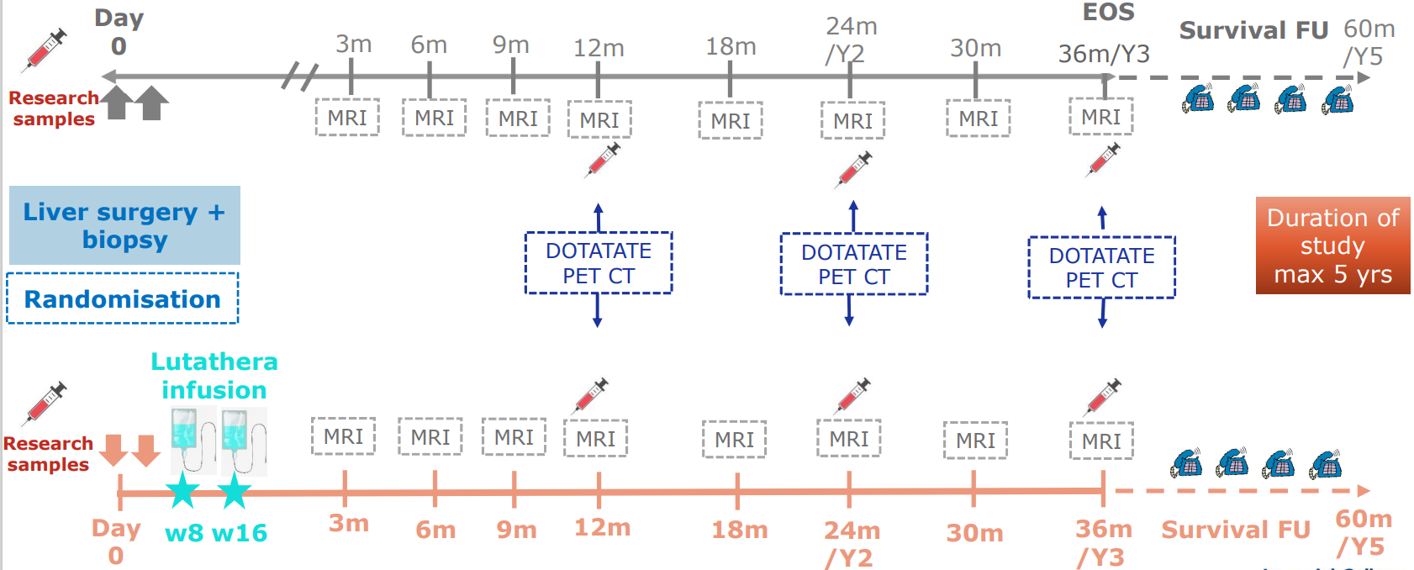
NELMAS: A multi-centre, stratified, open, randomized, comparator-controlled, parallel group phase II study comparing adjuvant treatment with ¹⁷⁷Lu-DOTATATE (Lutathera®) to best supportive care in patients after resection of neuroendocrine liver metastases (NE-LM)
Overall DFS after ADJUVANT Lutathera vs SOC in patients w R0/R1 resected liver metastases of G1/2 GEP- NETs & no extrahepatic disease
Key eligibility criteria
Patients with well diff. G1/2 (Ki67<20%) 1ary GEP NET after synchronous / metachronous 1^{ary} tumour & R0/R1 liver resection
MRI scan + ⁶⁸Ga DOTATATE PET/CT confirm LM & no extrahepatic disease
G3 NET or NEC
Prior PRRT or systemic treatment or other relevant treatments within 12W
Prior external RT to >25% BM
Incomplete tumour debulking of NE LM or non-resectable NE LM
106 patients UK (12 sites in set-up) & EU sites
Patient referrals: Prof Frilling
T: +44 (0) 20 33138542
E: a.frilling@imperial.ac.uk
Hammersmith Hospital
NIHR-adopted/ IRAS 1006904
RECRUITING!!
1st patient enrolled at Hammersmith!

Slide 7
LANTANA study
LANTANA (Sharma –Imperial)
Phase1b trial
¹⁷⁷Lu-DOTATATE + ASTX727 (Decitabine + Cedazuridine)
Evidence supports hypermethylation of SSTR gene promoters – decreased expression
Re-expression of SSTR₂ in tumours with low avidity by demethylating agents
Safety / tolerability

Slide 8
LANTANA study
Ki-67≤ 55% ( e.g. Gd 1-3NET )
Uptake on GaDOTATATE scan < background liver
PD or intolerance to 1st line therapies including SSA
ECOG – 0-2
Chief Investigator: r.sharma@imperial.ac.uk
Investigator: antonio.dalessio@nhs.net
Senior Research Nurse: caroline.ward1@nhs.net T: 02075942807
20 patients consented
14 patents recruited
Of patients treated – 6 show evidence of re-expression of SSTR by ASTX727
4 patients treated with PRRT
Still recruiting – referrals accepted.
6 Slots remain to be filled.

Slide 9
Immune checkpoint modulators in NET
NET Tumour + microenvironment – influence surrounding immune system
Studies have shown – GEP-NEN expression of PD-1 / PDL-1 and presence of TILs.
Evidence of prognostic significance – mixed.
Higher grade tumours – more TILs & higher TMB
Pembrolizumab –
Spartalizumab –
Toripalimab – phase 1b trial in GEP-NET and NEC. PDL-1 >10% + high TMB – ORR = 50%
Avelumab
Ipi/Nivo
Durvalumab/Tremelimumab
Atezo/Bev
Pembro/Lenvatinib

Slide 11
Genomic Analysis to guide clinical trials
TARGET NATIONAL study
FMI ctDNA analysis – 300+ cancer related genes
Patients without standard treatment option
Determining whether actionable mutations – improves entry into and responses in early phase clinical trials
3500 participants recruited
26 patients neuroendocrine cancer
Range of gene mutations
ATM, CDKN2A/B, CHK2, MSH2
ATRX, MEN-1, NF1, TSC
4 – 5 participants – clinical trial

Slide 12
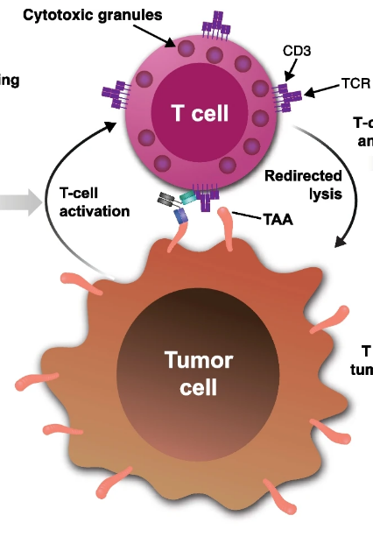
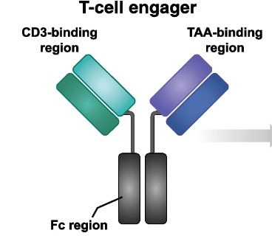
Studies in development
Dareon – 5 trial
BI764532 – DLL3 / CD3 IgG like T-cell engager
DLL3 over-expressed in cells with neuroendocrine
differentiation e.g. SCLC / NEC
Relapsed/refractory extra-pulmonary NECs
or large cell NEC of the lung, after ≥1 prior line of
therapy including at least one platinum-based regimen
Currently closed for interim analysis
McNamara (Christie, Manchester)
– likely open during 2025

Slide 13
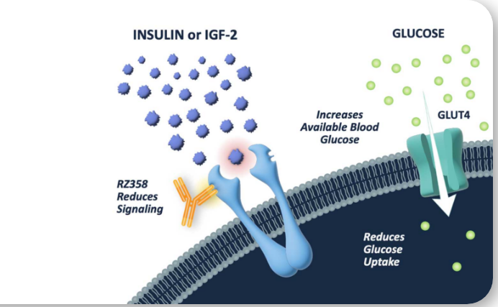
Studies in Development
– the power of the patient
RZ358 / ersodetug (Rezolute)
MAb binding to insulin receptor – allosteric
Modulation in signalling component.
Reduced effect of insulin / IGF2 on GLUT4
Current trial in Paediatric congenital
Hyperinsulinaemia (GOSH/MCH)
Planned trial – malignant insulinoma
10 sites USA / 5 sites Europe
Parallel Phase 2 trials –
symptomatic in-patients &
randomised phase II in less symptomatic
Out-patients
Likely opening Q2/2025.
Likely travel support for patients.

Slide 14
Closed / Never opened studies
SALUS – long term safety of Lutathera ( non-intervention trial )
ARTISAN – (Sharma) completed recruitment. 24 patients. 2/24 pt RILD. Awaiting information on personalised dosimetry.
Belzutifan ( MK 6842 ) – CI (UK) Sharma – completed recruitment.

